Slide 1






Speech Emotion Recognition Using LSTM (Long Short Term Memory)

Slide 2
Presented By:
1. Abdullah Al Sadnun (ID:19202103324)
2. Akash Kumar Nondi (ID:19202103325)
3. Md Shafiul Alam (ID:19202103327)
4. A.N.M Liazur Rahman (ID: 19202103344)
5. Md. Raju Raihan (ID: 19202103351)
Supervised By:
Md. Mahbub-Or-Rashid
Assistant Professor,
Dept. of CSE(BUBT)

Slide 3
Presentation Outline
Introduction
Motivation
Problem Statement
Objective
Literature Review
Dataset
Proposed Methodology
Experimental Result
Conclusion and Future Works
References

Slide 4

Introduction
Speech emotion recognition detecting emotions from joy to sorrow, expressed through human voices.
This field goes beyond language studies, blending artificial intelligence and psychology.
This technology has implications for human-computer interaction and mental health diagnostics.

Slide 5

Motivation
Understanding and interpreting emotions in speech can enhance communication between humans and machines, as well as between humans themselves.

Slide 6

Problem Statement
The classification of basic emotions, as well as the understanding of complex emotional blends in communication.
The complexity is compounded in program such as virtual assistants where real-time demands must be met.
Combine technology and understanding feelings to make computers better at picking up on how people feel when they talk.

Slide 7

Objective
Achieve superior emotion categorization, with a focus on the RAVDESS dataset (91.25%) and TESS dataset (98.05%).
Evaluate the overall performance of the LSTM model using the RAVDESS and TESS datasets to assess its generalization capabilities.
Address and resolve issues related to capturing dynamic emotional expressions in speech signals.

Slide 8

Literature Review

Slide 9
Reference | Title | Methodology | Result | Challenges
[1] Tursunov Anvarjon, Mustaqeem, and Soonil Kwon. Deep-net: A lightweight cnn-based speech emotion recognition system using deep fre quency features. Sensors, 20(18):5212, 2020. | Deep-Net: A Lightweight CNN-Based Speech Emotion Recognition System Using Deep Frequency Features | CNN F1-measure | 92.02% -> CNN 92% -> F1-measure | Modified pooling strategy and deep frequency features Analyzing Speech Signals
[2] Sadia Sultana, Md. Zafar Iqbal, M Reza Selim, Md Mijanur Rashid, and M Shahidur Rahman. Bangla speech emotion recognition and cross-lingual study using deep cnn and blstm networks. IEEE Access, 2021. | Bangla Speech Emotion Recognition and Cross-lingual Study Using Deep CNN and BLSTM Networks | CNN LSTM SVM | 56% -> CNN 68% -> LSTM 86% -> SVM | Combines DCNN and a BLSTM network with a time-distributed flatten (TDF) layer.
[3] JYOTIRMAY Devnath, Sabbir Hossain, MOSHIUR Rahman, HASI Saha, Md Ahsan Habib, and Nahid Sultan. Emotion recognition from isolated bengali speech. 2020. | Emotion recognition from isolated Bengali speech | MFCC KNN | 88% -> MFCC 87.50 % -> KNN | Limited Research Potential variations in results

Slide 10
Reference | Title | Methodology | Result | Challenges
[4] Babak Joze Abbaschian, Daniel Sierra-Sosa, and Adel Elmaghraby. Deep learning techniques for speech emotion recognition, from databases to models. Sensors, 21(4):1249, 2021. | Deep Learning Techniques for Speech Emotion Recognition, from Databases to Models | MFCC | MFCC -> 93.75% | Limited availability of datasets Cultural affect the emotional feeling
[5] Manas Jain, Shruthi Narayan, Pratibha Balaji, Abhijit Bhowmick, Ra jesh Kumar Muthu, et al. Speech emotion recognition using support vector machine. arXiv preprint arXiv:2002.07590, 2020. | Speech Emotion Recognition using Support Vector Machine | MFCC SVM | MFCC -> 72.785% SVM -> 85.085 % | Limited dataset Classifier selection
[6] Li-Wei Chen and Alexander Rudnicky. Exploring wav2vec 2.0 fine tun ing for improved speech emotion recognition. In ICASSP 2023-2023 IEEE International Conference on Acoustics, Speech and Signal Processing (ICASSP), pages 1–5. IEEE, 2023. | Exploring Wav2vec 2.0 Fine Tuning for Improved Speech Emotion Recognition | wav2vec 2.0 | pretrained models -> wav2vec 2.0 -> 74.3% | Overfitting Data efficiency

Slide 11
Dataset
RAVDESS (Ryerson Audio-Visual Database of Emotional Speech and Song):
RAVDESS is a widely used dataset for speech emotion recognition. It contains speech recordings with various emotions (happy, sad, neutral, etc.) spoken by both actors and actresses. The dataset also includes song samples. Each file is labeled with the corresponding emotion.
TESS (Toronto Emotional Speech Set):
TESS is a dataset that includes emotional speech recordings performed by two actresses. It covers a range of emotions, such as anger, disgust, fear, happiness, sadness, surprise, and neutral. TESS is commonly used for research in speech emotion recognition.
Combined RAVDESS and TESS Dataset:
RAVDESS dataset contains 1200 and TESS dataset contains 1800. And combine dataset is 3000.

Slide 12
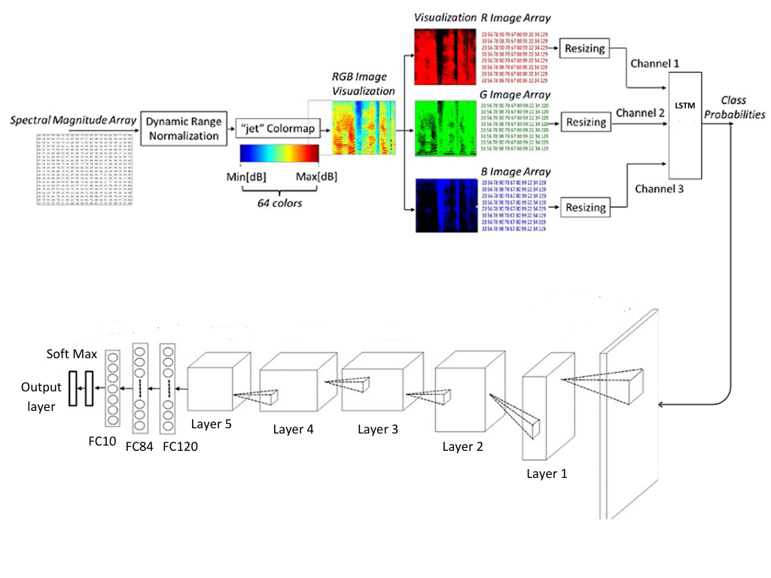
Proposed Methodology

Slide 13
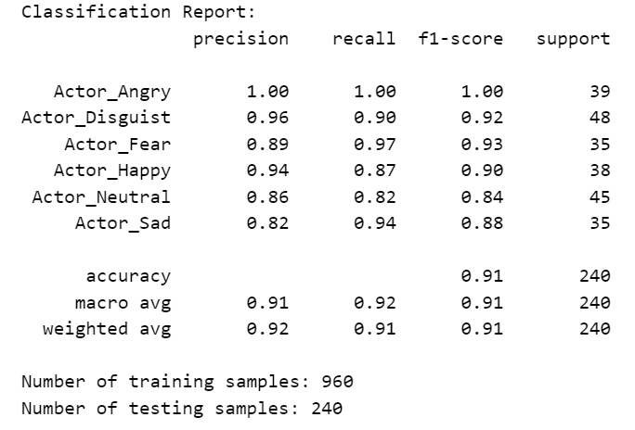
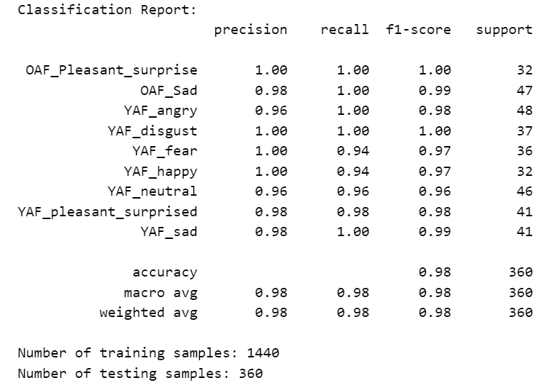
Experimental Result
RAVDESS Classification Report
TESS Classification Report

Slide 14
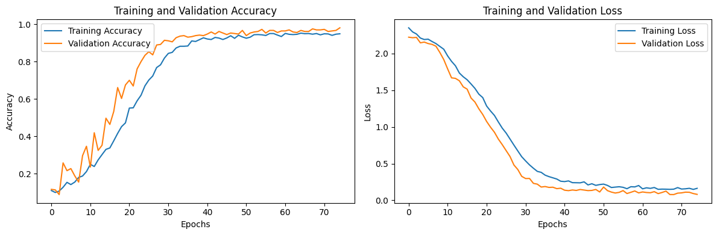
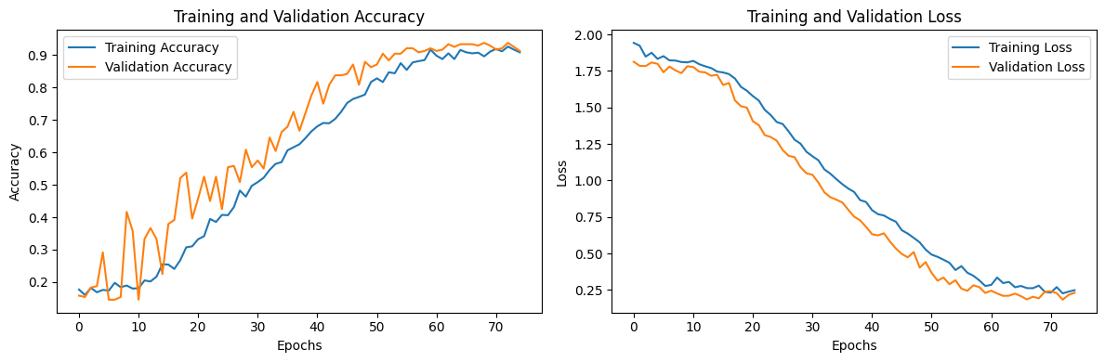
TESS accuracy and validation graph
RAVDESS accuracy and validation graph

Slide 15
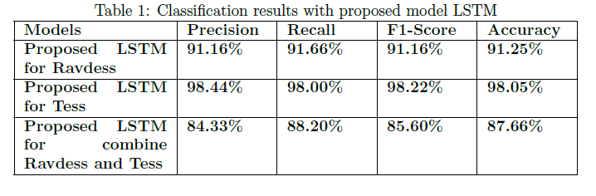
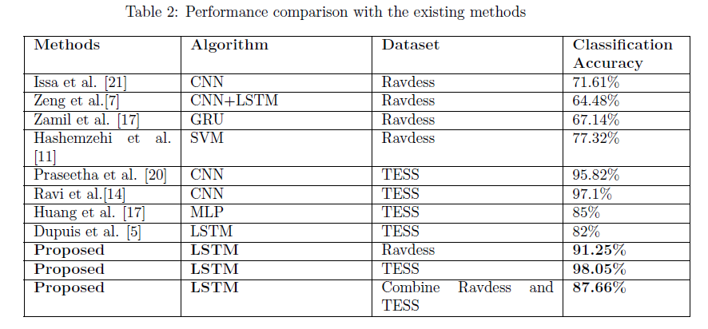

Slide 16

Conclusion
LSTM excelled in identifying emotional subtleties and capturing temporal dependencies in speech signals.
The study establishes a solid foundation for advancing Speech Emotion Recognition methodologies.
Adaptability in real-world scenarios and noisy environments during training is essential.

Slide 17
Future Works
Improve to clear random silence from the audio clip.
Improve the more efficiency and accuracy of emotion recognition models.
Improve Investigating model robustness across different languages.

Slide 18
References
.
[1] Tursunov Anvarjon, Mustaqeem, and Soonil Kwon. Deep-net: A lightweight cnn-based speech emotion recognition system using deep fre quency features. Sensors, 20(18):5212, 2020.
[2] Sadia Sultana, Md. Zafar Iqbal, M Reza Selim, Md Mijanur Rashid, and M Shahidur Rahman. Bangla speech emotion recognition and cross-lingual study using deep cnn and blstm networks. IEEE Access, 2021.
[3] JYOTIRMAY Devnath, Sabbir Hossain, MOSHIUR Rahman, HASI Saha, Md Ahsan Habib, and Nahid Sultan. Emotion recognition from isolated bengali speech. 2020.
[4] Mehmet Berkehan Ak¸cay and Kaya O˘guz. Speech emotion recognition: Emotional models, databases, features, preprocessing methods, support ing modalities, and classifiers. Speech Communication, 116:56–76, 2020.
[5] Babak Joze Abbaschian, Daniel Sierra-Sosa, and Adel Elmaghraby. Deep learning techniques for speech emotion recognition, from databases to models. Sensors, 21(4):1249, 2021.
[6] Manas Jain, Shruthi Narayan, Pratibha Balaji, Abhijit Bhowmick, Ra jesh Kumar Muthu, et al. Speech emotion recognition using support vector machine. arXiv preprint arXiv:2002.07590, 2020.
[7] Li-Wei Chen and Alexander Rudnicky. Exploring wav2vec 2.0 fine tun ing for improved speech emotion recognition. In ICASSP 2023-2023 IEEE International Conference on Acoustics, Speech and Signal Processing (ICASSP), pages 1–5. IEEE, 2023.

Slide 19
Thank You All
Any Question Please?

